Slide 1
Are You Ready
For The
Marketplace?

Slide 2
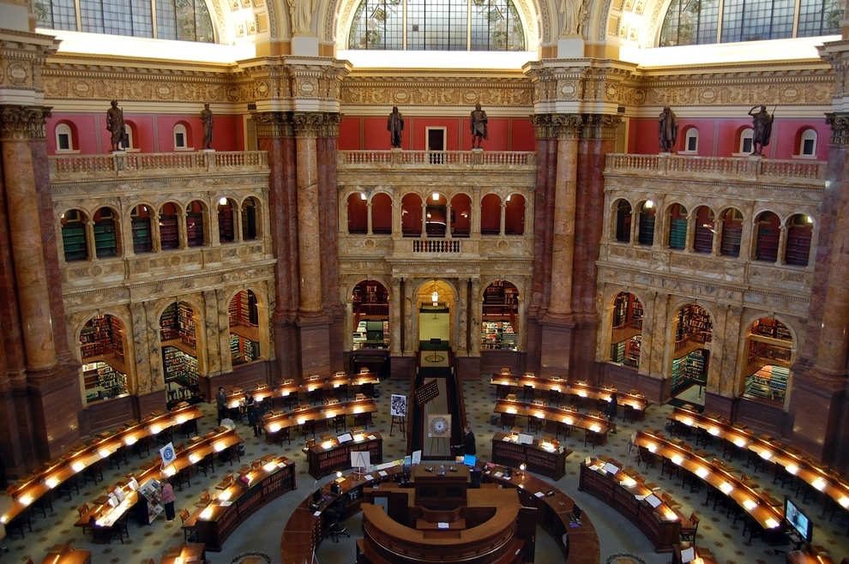
Over 3,000,000 books
were
published
last year

Slide 3
The Life of Your Book:
Editing
Designing
Packaging (Titling & Pricing)
Market research
Distribution plan
Fully executable distribution and marketing plan started 4 months before launch
Fully executable distribution and marketing plan that covers the 24 months after launch

Slide 4
Forget What You Know
Hardcovers no longer are the standard for “serious” books.
Digital Printing has improved in quality and you do NOT need to print thousands of books.
Newspapers & reviewers WILL review paperback books
Reviewers and bloggers will review POD books

Slide 5
Bookstores will stock POD books
Most of your friends will not buy or review your book
Libraries and bookstores cannot afford nor do they want expensive books by unknown authors
Books will not “sell themselves”
Your book is not the exception

Slide 6
What You Need to Ask:
Who needs or wants your book?
Why will they actually BUY it?
How will they hear about it?
What makes your book different?
What are you prepared to do to get it there?
When are you going to do what?

Slide 7
NOPE!

Slide 8
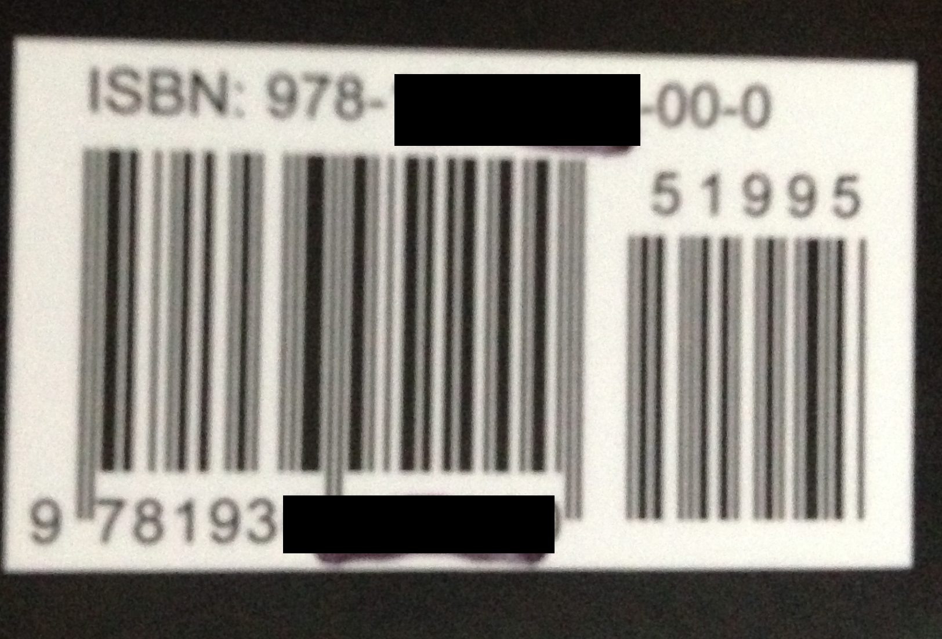
YUP!

Slide 10
Keep In Mind
Perhaps stores are not the best place to sell your book.
No one needs your book - They have to want it
A proper attitude, polite tone, and a desire to be helpful will get you MUCH further than your belief that your book will be a big seller….

Slide 11
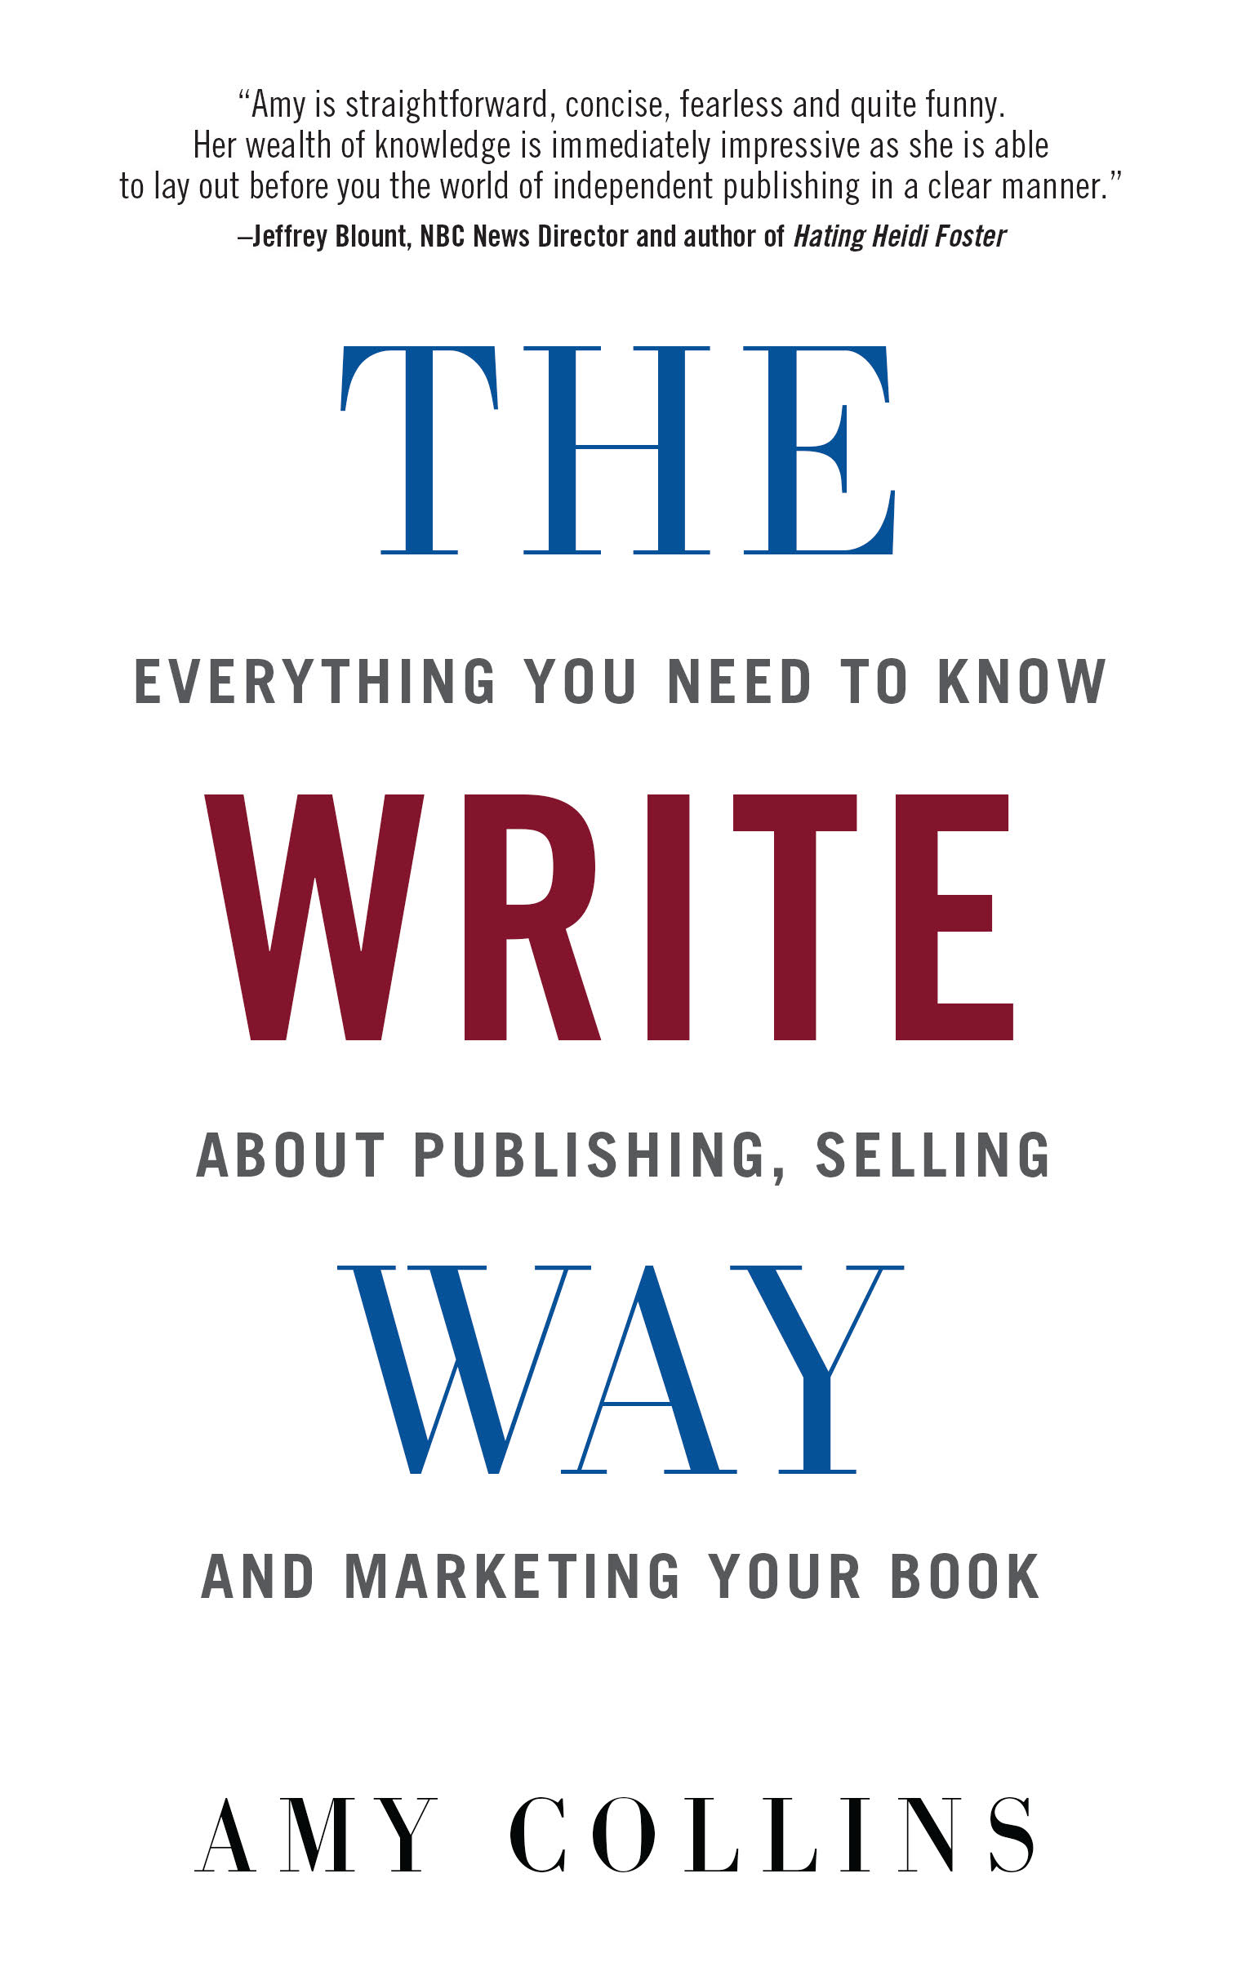
Please get in touch if you have any
questions!
Amy Collins
New Shelves Books
614 Fifth Ave
Troy, NY 12182
518.261.1300 X301 Phone
NewShelvesBooks Skype
amy@newshelves.com Email
www.newshelvesdistribution.com Website
http://twitter.com/NewShelvesBooks Twitter
https://www.facebook.com/newshelvesdistribution Facebook

